Slide 1

Proposal Defense
Team
Sheroz Khalid | 18F-0319
Fahad Usman | 18F-0181
Hamza Bhutta | 18F-0368

Slide 2

LOGO

Slide 3
Team/Company Name:
Tech Bazaar
Supervisor(s):
MR.Masood Habib
Co-Supervisor(s):
Dr. Umer Aftab
Project Name/Title:
Tech Bazaar

Slide 4
Outline
Introduction
Problem Statement
Motivation
Use
Impact of Software
Type of Project: R&D/Development
Project Scope
High Level Features
Related Projects
High Level System Diagram
Tools/Technologies/Environment
References
CS491-Project – Tech Bazaar

Slide 5
Introduction
Tech Bazar will be a web-based application aiding our users with easy access to the computer and electronic related products including computer and electronic accessories. Our major interest is to create as many possible ways to promote the products of respective sellers by posting ads on our web application and promoting them to interested buyers through email services. Allow our buyers to pay after product satisfaction and enable sellers and buyers to negotiate over the product. Keep shopping by category, New Arrivals of products and return/refund policy are some other additional features which will make our developed store stand out from the most already developed.

Slide 6
Problem Statement
The Problem of | People don’t have enough budget and traffic to create their own web based application for their businesses. They need an online application to establish their online store and emphasize their products in the market which are low on sales. For computer and electronic accessories specifically
Stack holders | Buyer, Seller and web application team
The Impact of | Business platform would establish specifically for computer and electronics market
A successful solution would be | web application which gives sellers free online space as a template for their computer and electronic accessories (based on their choice),and provide them free advertisement on our web application till they get their 1st week of sale.

Slide 7
Motivation
Now-a-days, online shopping has evolved, with new technological developments providing users with new and more extensive experiences. Business person don’t have platform feasibility and a market place to sell their tech goods in more efficient way.
Analyzing the market gap that most of the areas theirs requirement to get courier from certain platform with easily payment in the form of installments.
CS491-Project – Tech Bazaar

Slide 8
Impact of Software
This platform will bring innovation in the industry.
It will come with unique payment features and courier feasibility. It’ll help the business persons to grow in much better way.
Type of Project: Development
This is a Web Development based Project.
Three dimensional architecture

Slide 9
Project Scope
Online industry is flourishing rapidly, and facilitates various shopping related activities including purchasing and sales of products
This platform will keep users engaged as the it will continuously by notifying people about new products

Slide 10
High Level Features
Advertisement (ads)
Email marketing
Product Recommendation
Buyer and seller profiles etc.
Live Chat and messenger
Interest free installment methods (optional)
Price wise commission system.
Return and Refund Policy
Wish list discount notification
Courier Methods and Tracking system ( delivery status tracking )
Wallet Method and cash on delivery
The user will receive notification about creation and changes in order.
Rating and Reviews
Product Quality Negotiation before payment. (Unique)

Slide 11
Related Projects
Amazon:
Scammers
Bad logistics (damage products during logistic process and don’t provide courier options to buyer.
Amazon is incapable to deliver on time,
Amazon continues to attempt to take money from bank account no idea what for or why very disappointing
AliExpress :
Scammers in aliexpress take credits and cause loss to buyers
Logistic system failure, false status tracking of delivery
Cannot build good relationship between buyer and seller

Slide 12


Tools/Environment
Frontend: React JS
Backend: Firebase

Slide 13
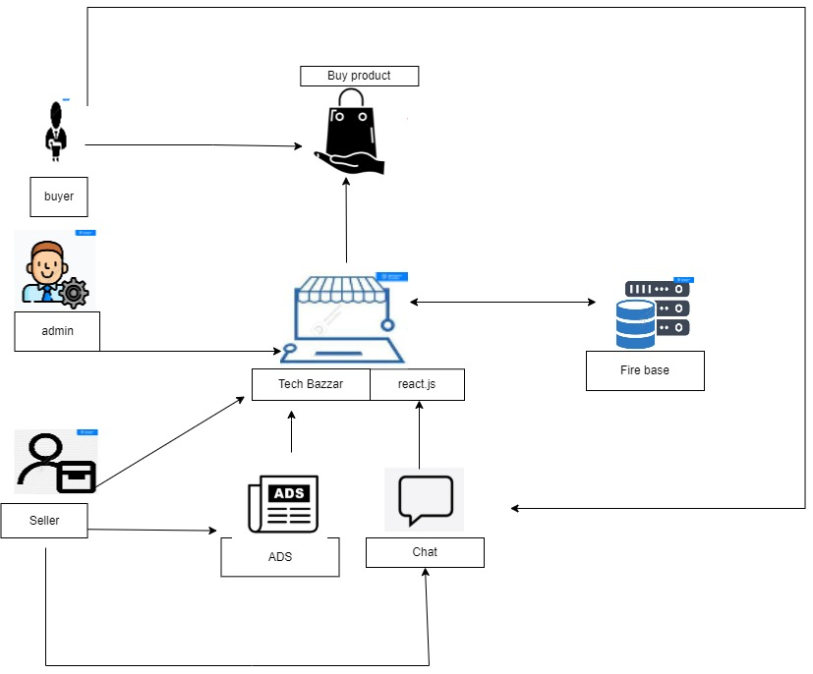
High Level System Diagram

